Slide 1
Digital Portfolio
STUDENT NAME:Abisha M
REGISTER NO AND NMID: 41424134141802522003
DEPARTMENT: II B.sc.cs
COLLEGE: COLLEGE/ UNIVERSITYS :t Therasa arts and clg for women/Annamalai University

Slide 2
PROJECT TITLE
Student profile

Slide 3


AGENDA
Problem Statement
Project Overview
End Users
Tools and Technologies
Portfolio design and Layout
Features and Functionality
Results and Screenshots
Conclusion
Github Link
3/21/2024 Annual Review

Slide 4

PROBLEM STATEMENT
Problem Statement: Student Profile Description System
In many educational institutions, student data is often scattered across various systems or stored in static formats that do not effectively represent a student's academic progress, skills, interests, and achievements in a holistic and personalized manner. This lack of a centralized, structured, and dynamic student profile system makes it difficult for educators, administrators, and even students themselves to track growth, identify strengths and weaknesses, and plan academic or career paths efficiently.
There is a need for a comprehensive Student Profile Description System that can capture, organize, and present detailed information about a student’s academic records, co-curricular activities, technical skills, projects, certifications, interests, and personal achievements in a clear and insightful format. The system should also support real-time updates and be user-friendly for both students and faculty

Slide 5

PROJECT OVERVIEW
🔹 Project Overview: Student Profile Description System
The Student Profile Description System is designed to provide a centralized digital platform for creating, managing, and showcasing comprehensive student profiles. The aim of the project is to move beyond traditional static records by developing an interactive and dynamic profile system that captures every key aspect of a student's academic and personal development journey.
This system allows students to input and update their academic details, project work, skills, achievements, extracurricular activities, certifications, and other relevant information in a structured format. The platform will generate a detailed, visually organized profile that can be used for internal academic tracking, resume building, placements, and other professional opportunities.
Educational institutions can also benefit from the system by gaining a clear overview of student performance and engagement, which helps in mentoring, personalized guidance, and decision-making related to academic interventions or career support.
The system will be developed with a focus on user-friendly design, data accuracy, real-time updates, and secure access control for both students and authorized faculty or administrators.

Slide 6

WHO ARE THE END USERS?
1. Students (Primary End Users)
How they use it: View and update their personal, academic, and career-related information.
Purpose: To track progress, manage course registrations, monitor grades, apply for services.

Slide 7

TOOLS AND TECHNIQUES
🔧 TOOLS for Student Profiling
1. Digital Tools
2. Assessment Tools
3. Communication Tools

Slide 8
POTFOLIO DESIGN AND LAYOUT
1. Structure & Navigation
The digital portfolio should be:
User-friendly with a clean, minimal design
Easy to navigate with a clear menu or sidebar
Mobile-responsive for access on all devices
🔖 Suggested Sections (Menu Tabs):
Home / About Me
Academic Records
Skills & Competencies
Projects & Assignments
Assessments & Reflections
Extracurricular Activities
Certificates & Awards
Career Goals / Future Plans
Feedback / Recommendations
Contact Information
8

Slide 9
FEATURES AND FUNCTIONALITY
🎯 Purpose
To provide a centralized, organized, and interactive digital record of a student’s:
Academic performance
Skills and competencies
Personal growth
Career interests
Behavioral patterns
1. Assessments & Test Results
Standardized test scores (SAT, MAP, etc.)
Formative and summative assessments
Diagnostic or placement test results
Learning style or personality test results
🟢 Functionality: Visual analytics (bar charts, line graphs, score comparisons)

Slide 10
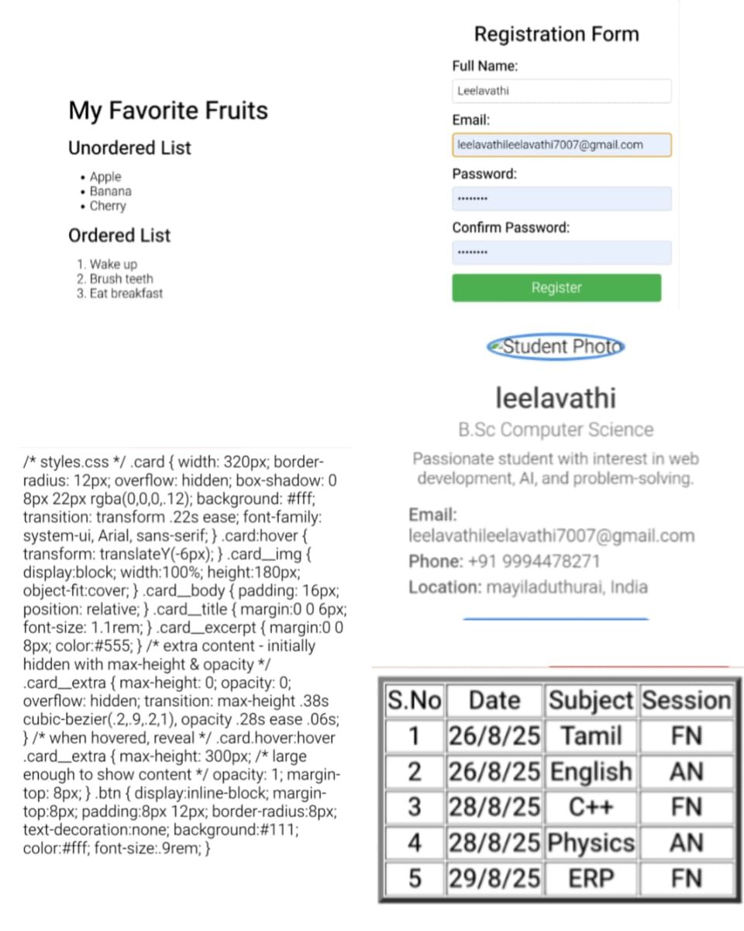
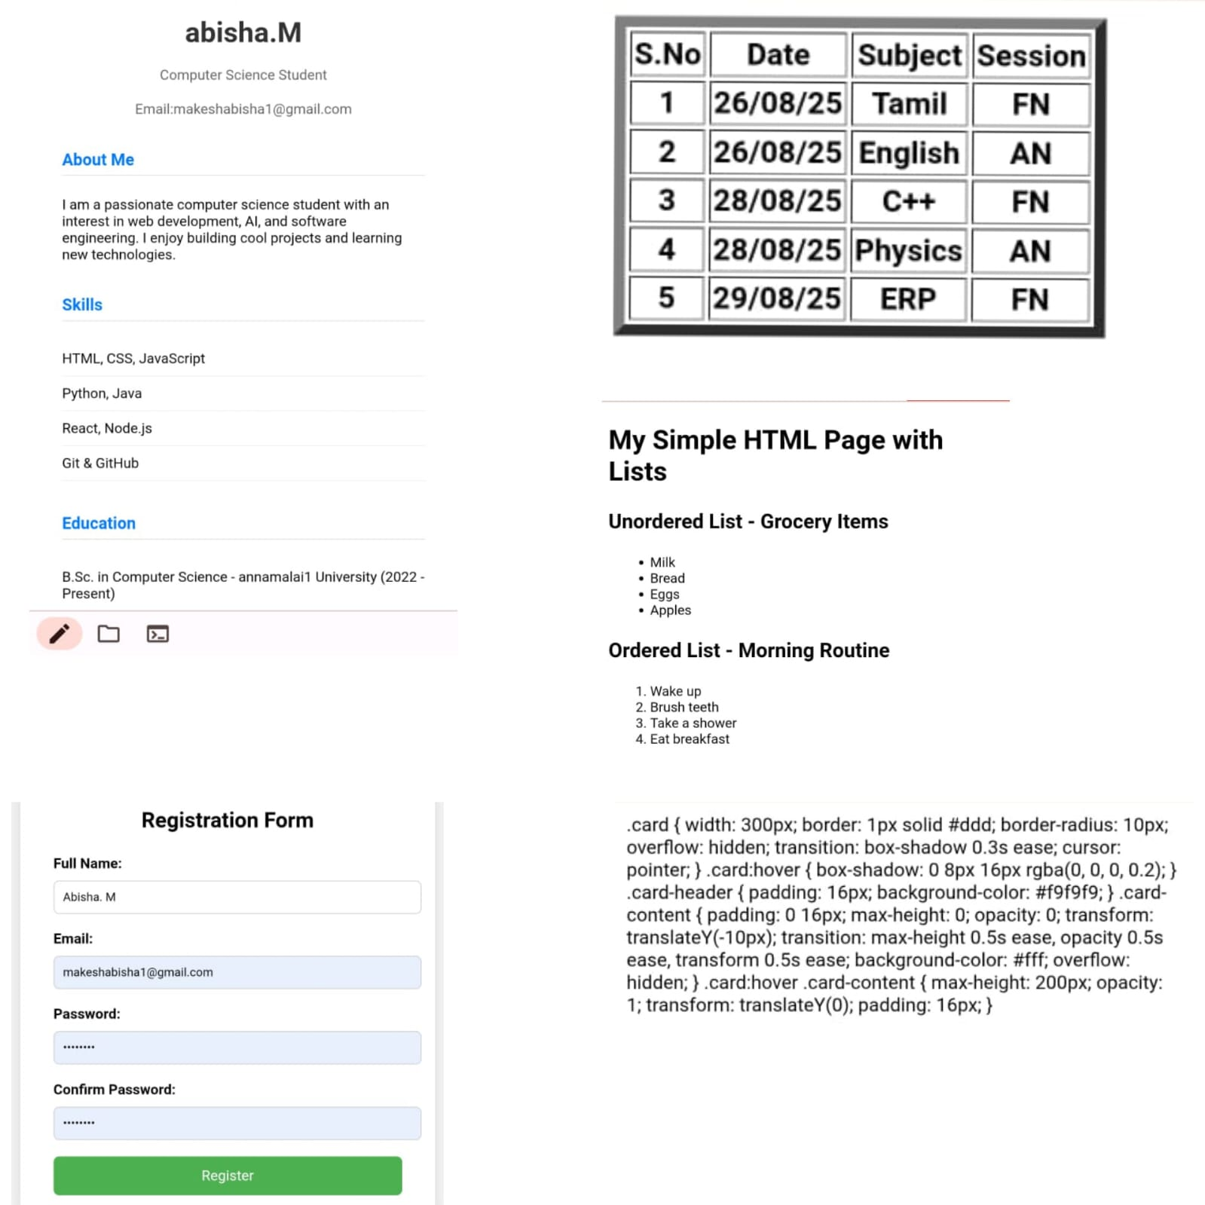

RESULTS AND SCREENSHOTS
3/21/2024 Annual Review
10

Slide 11
CONCLUSION
In conclution Abisha is a dedicated and driven individual with a passion for learning. As they on continue their educational journey the are poised to make valuable contribution and achieve their goals.
11

